Slide 1

OpenMP for Python
Caleb Huck
cthuck42@tntech.edu
www.calebhuck.me

Slide 2

Organization
Background
Contribution
Related Work
Design
Software Architecture
Microbenchmarks
Conclusions & Future Work
Compare with C++
Code Translation
Software Demo
Notes:
Here is the organization for the rest of the presentation. I’ll start with background on the project and the motivation for it. Then I’ll cover the contribution of this project and related work. Then I’ll talk about the design and software architecture and the specifics of how it works and I’ll end with a quick demo of how to run a couple small program. And last will be the microbenchmarks we used to test performance and conclusions and future work.

Slide 3
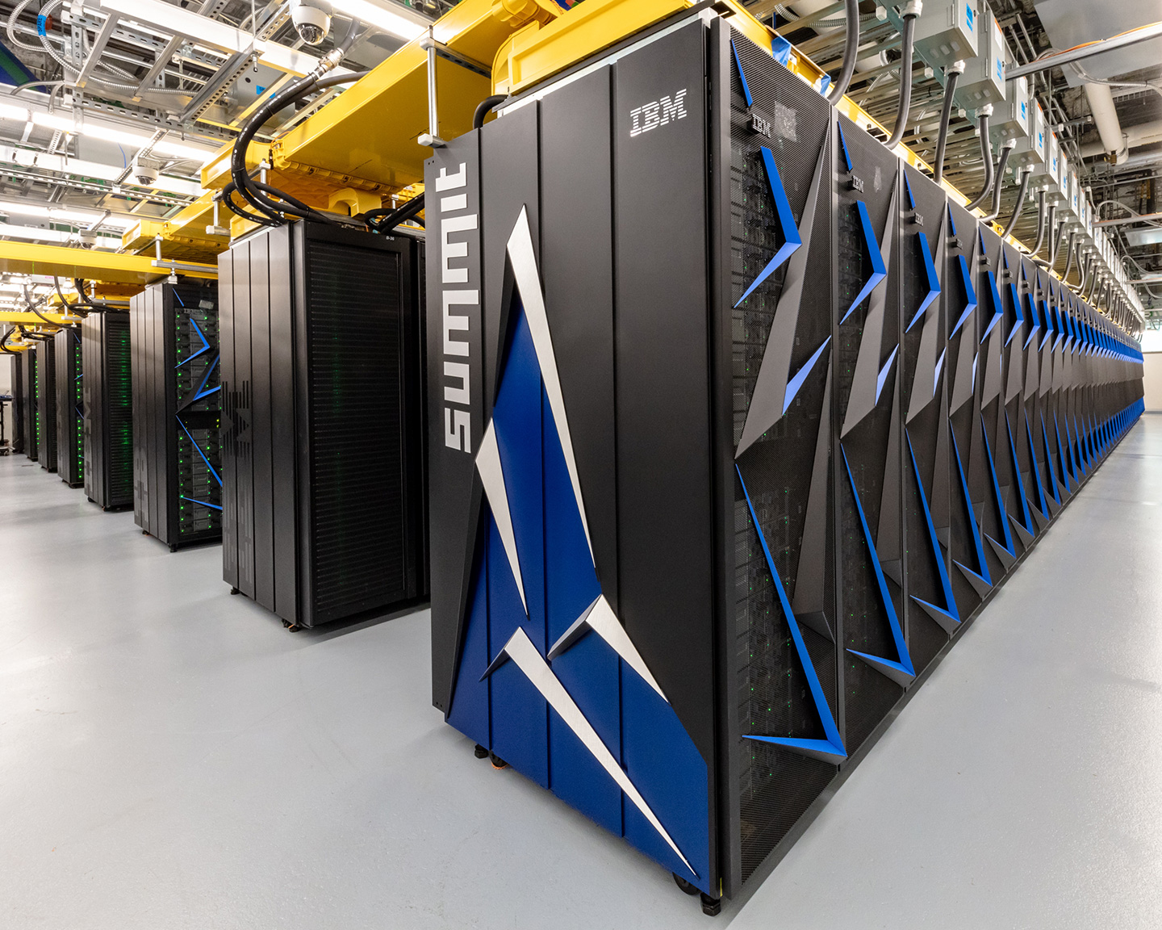

Background
Multi-core computing has become the standard
Essentially all hardware is parallel
Core 1
Core 2
Core 3
Core 3
Core 4
[f.1]
[f.2]
Notes:
So, let’s start with some background. In terms of hardware, almost everything today is parallel.
From budget laptops all the way up to supercomputers, it’s all parallel.
- And we’re only moving more and more in the direction of parallelism, which is logical
1) we get more computing power
2) the real world is also parallel. Things happen at the same time, independently of each other, and that’s normal.
So, it makes sense that the computing paradigm would naturally move in the same direction.

Slide 4



Background
Industry
Demand for parallel programming skills
Academia
Still operating in serial
Changing accreditation standards
Elective Requirement
All programs, not just HPC
Research to integrate [1-12]
[f.5]
[f.4]
[f.3]
Notes:
So, what are the practical implications of the shift towards parallelism in computing?
- Well, in the industry, there is a huge demand for computer scientists and programmers who have the skills and understanding to work with parallel systems whether directly or indirectly.
- Not every programmer is going to be writing parallel code or anything performance oriented necessarily.
- But they still need to have understanding of the systems that their code will run on and be able to think in terms of parallelism.
- The problem is that, in academic environments, the curricula is still emphasizing serial coding and thinking which obviously needs to change.
- And it is, the newest ACM and ABET standards are calling for parallel concepts to be taught earlier in the coursework, even in introductory CS classes.
- And they’re being taught in required classes rather than just in electives as they were in the past.
-AND they are being required for all programs, not just high performance computing, so cyber security students, data scientists, everyone
- And there has been a lot of research exploring the best way to start integrating this new material into the existing curricula, I’ve included a few recent examples in the references.

Slide 5


Background
iPDC (Integrating Parallel and Distributed Computing in Introductory Programming Classes) [13]
Provide training and resources
Workshops
Lecture
Hands on exercises
Modules
Programming
“Unplugged”
[f.6]
Notes:
- iPDC is an initiative here at Tennessee Tech that focuses on providing professors with resources and training on how to teach parallel concepts in early CS courses.
- Professors can attend one of the workshops where they go through some basic lectures on parallel concepts and fundamentals and then participate in hands on programming exercises.
- There are also teaching modules on the iPDC website that anyone can access and use and include programming exercises as well as what we call “unplugged” activities where parallel concepts are taught without using programming or computers.
- And these are great for getting students to connect the concepts to real life and think in parallel because that really is our main goal, to teach them how to think in terms of parallelism and concurrent dependencies not just get really good at writing threaded code or using some multithreading library

Slide 6

[f.7]
Notes:
I ran across this image while watching a conference presentation talking about Python asyncio and ironically enough, they were talking about how the Python global interpreter lock is a feature instead of a limitation.
- If you don’t know what the global interpreter lock is, I’ll cover that more later.
- But the sentiment of this photo isn’t completely without merit.
- Writing parallel code is hard, for several different reasons.
- One of them is that thinking in parallel doesn’t always come naturally right away, particularly to new programmers.
- And depending on the programming model, everything you have to keep up with to avoid things like race conditions and deadlocks can quickly get complicated and difficult to manage.
- So, it is important to keep this in mind when choosing a model for teaching parallelism
- And that is where OpenMP comes in

Slide 7
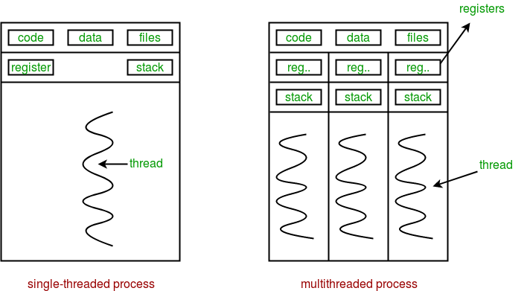
OpenMP
Open Multi-Processing
Shared-memory parallel library
1997 - present
Removes responsibility for thread creation and management from programmer
Abstract preprocessor-level directives and clauses
Rewrites source code before compiler sees it
Runtime library
[f.8]
Thread 0
Thread 0
Thread 1
Thread 0
#pragma omp parallel
{
/*parallel code block*/
}
Thread 2
Notes:
OpenMP or Open Multiprocessing is a shared-memory multithreading library that is used in the IPDC workshops.
- It was first released for FORTRAN in 1997 as a 60 or so page document and has since gone through quite a few revisions.
- The latest version is up to over 700 pages and has added lots of new features and abilities.
- The most important thing that OpenMP does is that it removes the responsibility from the programmer for thread creation and management.
- This is great because the programmer can focus on how they want their code to be run in parallel without all the extra overhead of writing the low-level threading code.
- Instead, they describe how the code should be run using high level compiler directives and the code is transformed into the equivalent threaded code automatically.
- That image at the bottom there shows just how little boilerplate code is required to have a basic parallel region.
- That simple directive will automatically create threads and execute the next block in parallel and that’s it.
- This is very useful for teaching parallel concepts to new students because they are better able to focus on the concepts themselves instead of putting their effort towards learning the ins and outs of a traditional threading library

Slide 8
Problem
Top three languages used in teaching early CS:
C/C++
Java
Python
OpenMP only supports FORTRAN, C, C++
Several Java implementations with varying usability (covered later)
No implementations in Python
Notes:
So, what is the problem?
- Currently, the top three languages used for teaching early CS classes is C or C++, Java, and Python.
- And they all have roughly equal market share across universities.
- Out of these, OpenMP only supports C/C++.
- There have been a few projects that implemented OpenMP in Java, and I’ll talk more about those in a minute.
- But to our knowledge, there haven’t been any implementations in Python until now

Slide 9
Contribution
Core OpenMP functionality in Python
Directives and clauses
Runtime library
Teaching, not performance
Concurrency
Parallelism
Speedup
Efficiency
Synchronization
Etc.
Thread 0
Thread 0
Thread 1
Thread 0
Thread 2
Notes:
So, that is exactly what we have been working on.
- The goal of this project has been to implement core OpenMP directives, clauses, and runtime functions, in python.
- And I’ll explain what I mean by core on the next slide.
- But first, I want to emphasize that this is a teaching tool, not a real-world performance library.
- And Python isn’t a performance language.
- What we want is to be able to demonstrate the effects of applying parallelism to different problems, but we certainly don’t expect to achieve the same kind of scaling or efficiency that we could get with C.
- Our goal is to have the same benefits of OpenMP for teaching concepts like speedup, efficiency, and synchronization, but in the Python language

Slide 10
OpenMP Core
Directives | Clauses | Runtime Functions
parallel | num_threads([t]) | omp_get_thread_num()
for | reduction([op]:[var]) | omp_get_num_threads()
parallel for | shared([var₁], [var₂],…,[var_{n}]) | omp_get_wtime()
barrier | private([var₁], [var₂],…,[var_{n}])
critical
Notes:
As I mentioned earlier, the OpenMP specification has grown tremendously since it was first released, however, the core of OpenMP has pretty much been around since the beginning.
- And what I mean when I say core, I'm talking about the parts of OpenMP that make up most of OpenMP programs even today and, on their own, are sufficient to write almost any parallel algorithm.
DIRECTIVES
- The parallel directive is responsible for creating new threads, and executing the next block in parallel
- The for directive is a work-sharing construct that is specific to for loops.
- It will take a normal for loop and automatically divide the iterations among whatever threads are available in the current block.
- Parallel for is just the combination of the first two, it spawns new threads and then executes the for loop in parallel
Barrier is a synchronization directive that forces threads to wait at the barrier until all threads have reached the barrier, then they can continue
Critical is used to guard any code that can result in race conditions if it is executed by multiple thread in parallel, so that code in a critical block will be serialized
CLAUSES
num_threads is always used with the parallel directive and just sets the number of threads to create
Reduction takes an operation and a variable as arguments and will create a private version of the variable for each thread.
At the end of the parallel region, the results from each thread will be aggregated according to the operation and put back in the variable from the outer scope
Shared takes one or more variables as arguments and will make them shared between all the threads, so they will all be referencing the same variable from the previous scope
Private also takes one or more variables as arguments and will create a separate local copy for each thread
RUNTIME
And for the runtime functions, omp_get_thread_num() returns the id of the current thread, which is always an integer that starts at 0 and counts up depending on the number of threads
Omp_get_num_threads() returns the number of threads executing the current region
And omp_get_wtime is generally used for timing how long it takes for some code to run

Slide 11
Related Work
Jomp [14]
Released in 2000
Java 1.x and OpenMP version 1.0
Two phase compilation (.jomp .java .class)
Pyjama [15]
Released in 2013
Java 7 and OpenMP 4.x
Two phases combined to single application (.java .class)
Used in iPDC
Omp4J [16]
Released in 2015
Java 8 and OpenMP 4.x
Similar to Pyjama
No runtime library
Notes:
There have been several projects in the past that implemented OpenMP in Java.
- Each of these had problems with usability and sometimes correct function, and we learned a lot from using them and exploring their source code.
- The problems we had with them helped form a basis for our usability goals in order to have a software product that is easy to use for early CS students and professors so that it can be a practical teaching tool.
- So that is why I have included them here and I’ll just cover them briefly.
JOMP
- Jomp was the first project in 2000. It required the user to write their code in a .jomp file, which was standard java code with the OpenMP directives as single line comments.
- Then they would run it through the jomp preprocessor to generate the java files which could be compiled and run like a normal java program.
- So there were a lot of steps involved to using it.
PYJAMA
- Pyjama made the process simpler by combining the preprocessor with the compiler, so you could write your code in .java files and then run one tool to generate the class files.
- Pyjama seems to be the most complete and usable of the three which is why it is currently used in the java portion of the iPDC workshops.
OMP4J
- Finally, Omp4j was the latest project and was quite similar to pyjama except for the fact that they didn’t implement a runtime library. Instead, they had some preprocessor-level macros that seemed to break in many circumstances and didn’t work reliably

Slide 12
Design
Design Goals
Easy to download, install, and use
Early students and professors
Provide helpful error messages for debugging
Integrate with IDEs
Follow original OpenMP syntax/style
Notes:
So, like I said we learned quite a bit from the Java versions and even though Python is a different language, we draw a lot of our design goals from our experience with them.
1) First, we want our software to be easy to download, install, and get started using.
- This is important since for one, we expect many of our users to be early CS students and if the software is hard to use or complicated to install correctly, then they will have a lot of problems and then professors have to spend their time helping them get it corrected.
- Also, professors tend to be busy people and many of them may not have the time to troubleshoot and figure out how to use the software if it isn’t straightforward.
2) We also want to provide helpful error messages.
- One of our main frustrations with the Java versions was that errors that got through the preprocessor would show up as java compiler errors from the transformed code (not the original that the user wrote) and so had nothing to do with the user’s code which makes debugging really difficult.
- Also, since one java file would generate multiple class files, the error you get isn’t even from the same file which makes it even more difficult.
- Another of our goals, is to be able to use our tool effectively and easily with IDEs. Which isn't something we've really been able to test just yet, but we plan to in the future.
- Lastly, we want to maintain as much familiarity with original OpenMP as possible in terms of syntax and style

Slide 13
Python Obstacles
[f.9]
Notes:
As you might imagine, we faced some problems making OpenMP work in Python.
- Python is very different from C in terms of syntax and programming paradigm.
- It’s interpreted instead of compiled.
- Also, whitespace and indentation matter in Python and there are no primitive types, everything is an object.
- And overall, Python was just not written to be a performance language all on its own
- So, there were three primary obstacles I want to talk about that we had to deal with early on in the project

Slide 14


Python-Related Obstacles
Problem
Solution
CPython GIL (Global Interpreter Lock)
Jython Interpreter (No GIL)
[f.10]
[f.11]
Notes:
The first was the global interpreter lock that I referenced earlier.
- In CPython, which is the most common interpreter used today, anytime a thread accesses any shared resource, the interpreter is locked for all other threads.
- This helps prevent things like race conditions, but it also effectively serializes multithreaded code, which makes it just about impossible to get any speedup.
- To solve this problem, we use the jython interpreter.
- Jython is a java-based python interpreter that was implemented without a global interpreter lock and uses java threads under the hood

Slide 15
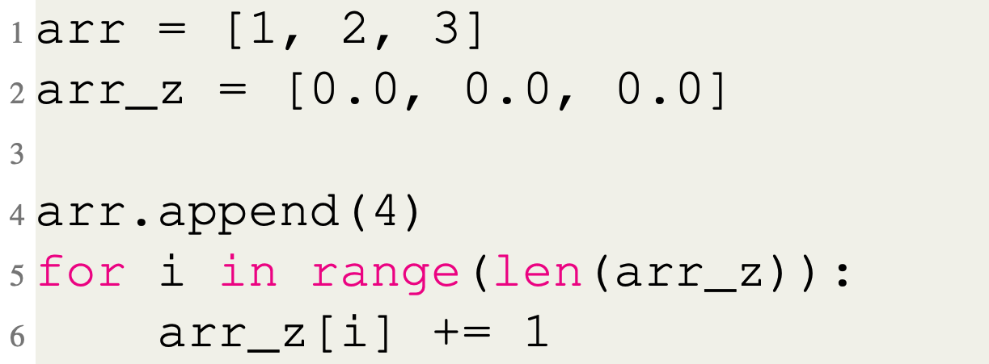
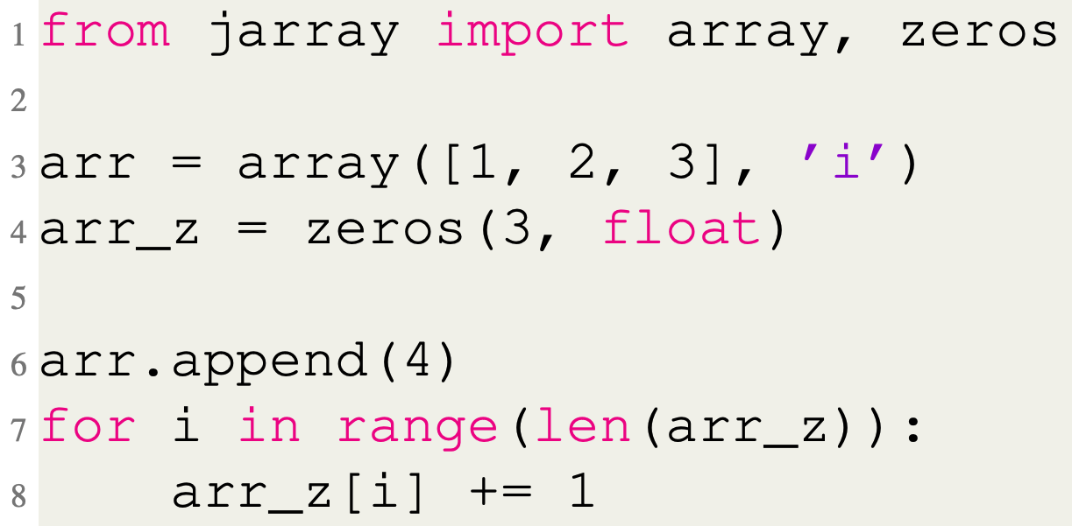
Python-Related Obstacles
Problem
Solution
jarray.array & jarray.zeros
Data Structures
Notes:
Another problem we faced has to do with data structures.
- In C, we use arrays a lot with OpenMP.
- But in python, there is no primitive array type, instead we have list objects.
- And the problem with lists is that even in jython, they are automatically locked for both reading and writing, even if you’re reading from or writing to different index locations in the list.
- We found a partial solution to this problem.
- Jython includes a module called jarray that has two functions, array and zeros.
- These both return a Python object that wraps an underlying Java array and has almost identical member functions and usage to lists.
- Using these we can at least get parallel reading from the array, but writing is still serialized unfortunately.
- The two code examples on this slide do the exact same thing and show the difference in how you create a jarray list compared to a regular list.
- After you create them, they work pretty much exactly the same

Slide 16
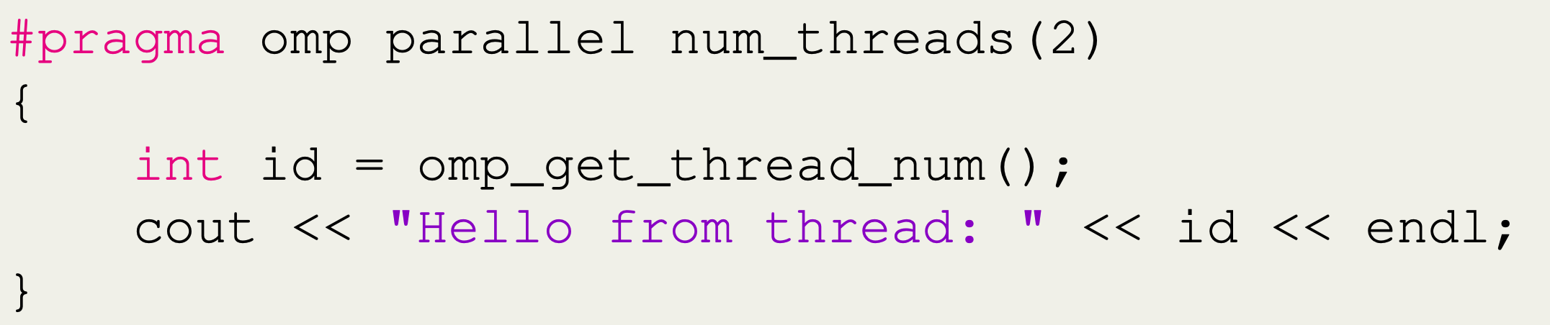
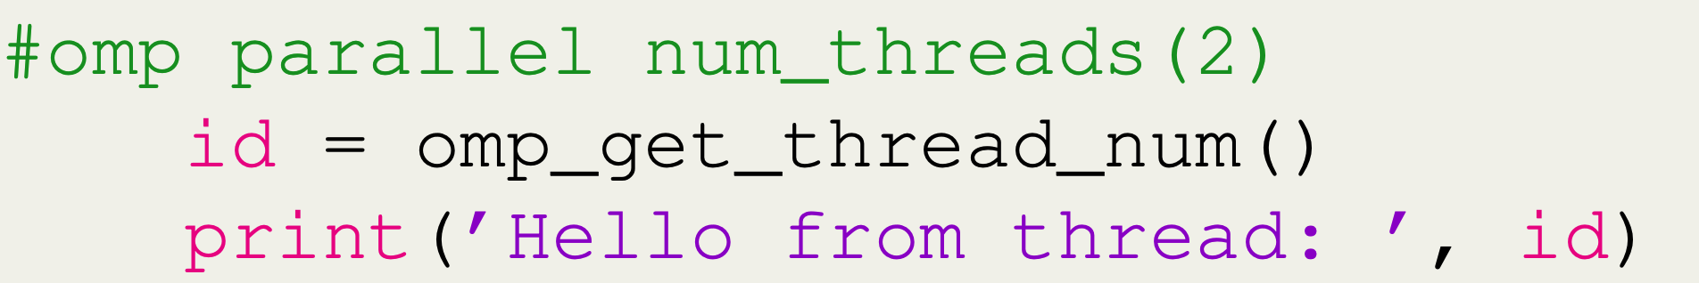
Python-Related Obstacles
Problem
Solution
Modify Python syntax
Scope
C++
Python
*Breaks compatibility with standard Python
Notes:
Lastly, in python, there is no way to define an arbitrary new scope.
- In C you can use curly braces to create a new scope wherever you want, but in python there is no syntax to do that.
- And we need to be able to define scopes local to our OpenMP directives
- To fix this, we changed the python syntax in our parser to allow an OpenMP comment to come before an indented block, which is how scopes are defined in Python.
- The only downside to this is that we lose compatibility with standard python interpreters if the code isn’t run through our preprocessor first, because, as you can see, it will appear as a comment followed by an indented block, which is illegal in Python.
- We felt it was worth it to make this compromise because it lets us stay consistent with Python indentation with our OpenMP blocks and should be more intuitive to users

Slide 17
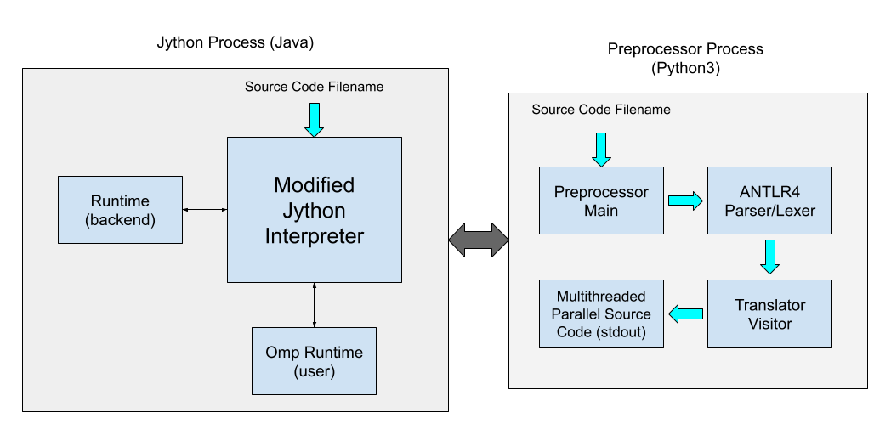
Software Architecture
Jython (Java) Process
Modified to call preprocessor before executing code
Backend runtime
User runtime
Preprocessor (Python 3) Process
ANTLRv4 Parser Generator
Visitor pattern
OpenMP Code Threaded Code
Transformed code/error printed to stdout
Notes:
Here is a high-level overview of the architecture of the software.
- The bright green-blue arrows show the path of the source code through the program.
- As you can see, it involves two operating system-level processes running at the same time.
- One is a java process, and the other is a Python 3 process.
- Early on in the project, we started working on the preprocessor and experimenting with code transformation before we settled on a solid direction for the project.
LIMITATIONS
- One of the limitations of Jython that made us hesitate to use it is that it only supports Python 2.7, so we explored a lot of other options to see if we could find a way to use Python 3, but unfortunately none of them panned out.
- So, by the time that we settled on using Jython, we had already committed to writing the preprocessor in Python.
- So that’s why there are two processes. We used the Java ProcessBuilder API to start the Python process from Jython and pass the program file name as an argument so that it's transparent to the user.
PREPROCESSOR
- Inside the preprocessor, we use ANTLR 4 to lex and parse the source code.
- After that, we use the visitor design pattern to traverse the abstract syntax tree produced by ANTLR and generate the multithreaded code.
- If all of that completes without an error, the multithreaded code is sent to stdout.
JYTHON
- Then on the java end, stdout and stderr are captured and if there was an error, then the error message is displayed and the program exits, otherwise, the transformed code is written to a temporary file and then executed.
BACKEND
- While it’s running, the code relies on our backend runtime library.
- The backend runtime handles things like running parallel targets with the correct number of threads and managing OpenMP for loops and a few other things related to how the OpenMP blocks are executed.
I’ll show some examples of how it fits in in the next couple of slides.
So, finally, there’s the user runtime and that contains the OpenMP core functions from the earlier slide

Slide 18
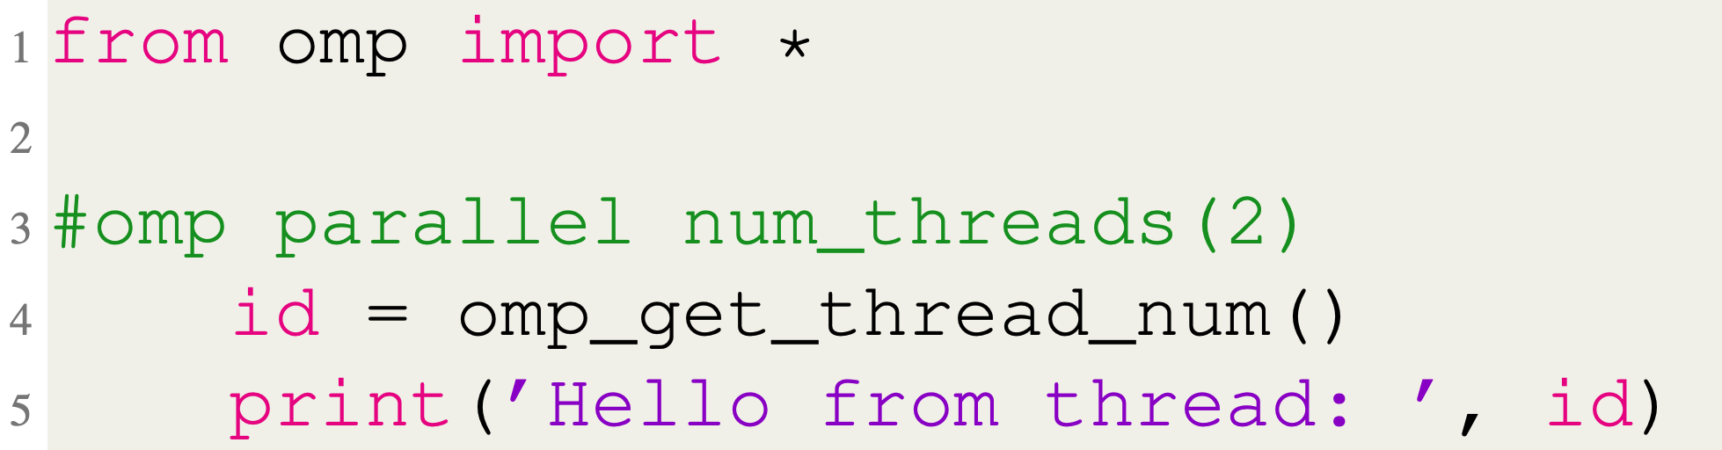
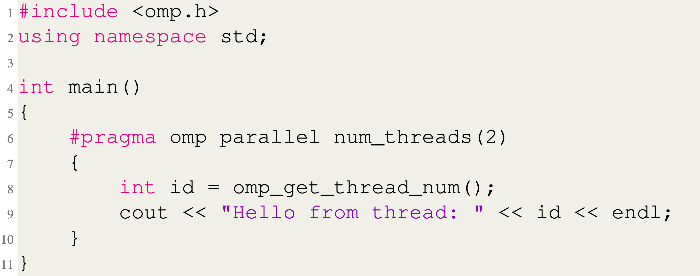
Parallel Directive
Python
C++
Notes:
Before I go into how the code is translated from OpenMP to threaded code, I want to briefly show the difference side by side how it looks in python compared to the original in C++.
- These code blocks do the exact same thing.
- They both just print a simple message saying hello from the thread’s id.
- Syntactically, the only thing we changed in the Python version is that you don’t have to put the “pragma” at the beginning of the directive.
- In C and C++, pragma comes before a compiler directive, but since it has no meaning in Python, we just start with omp

Slide 19
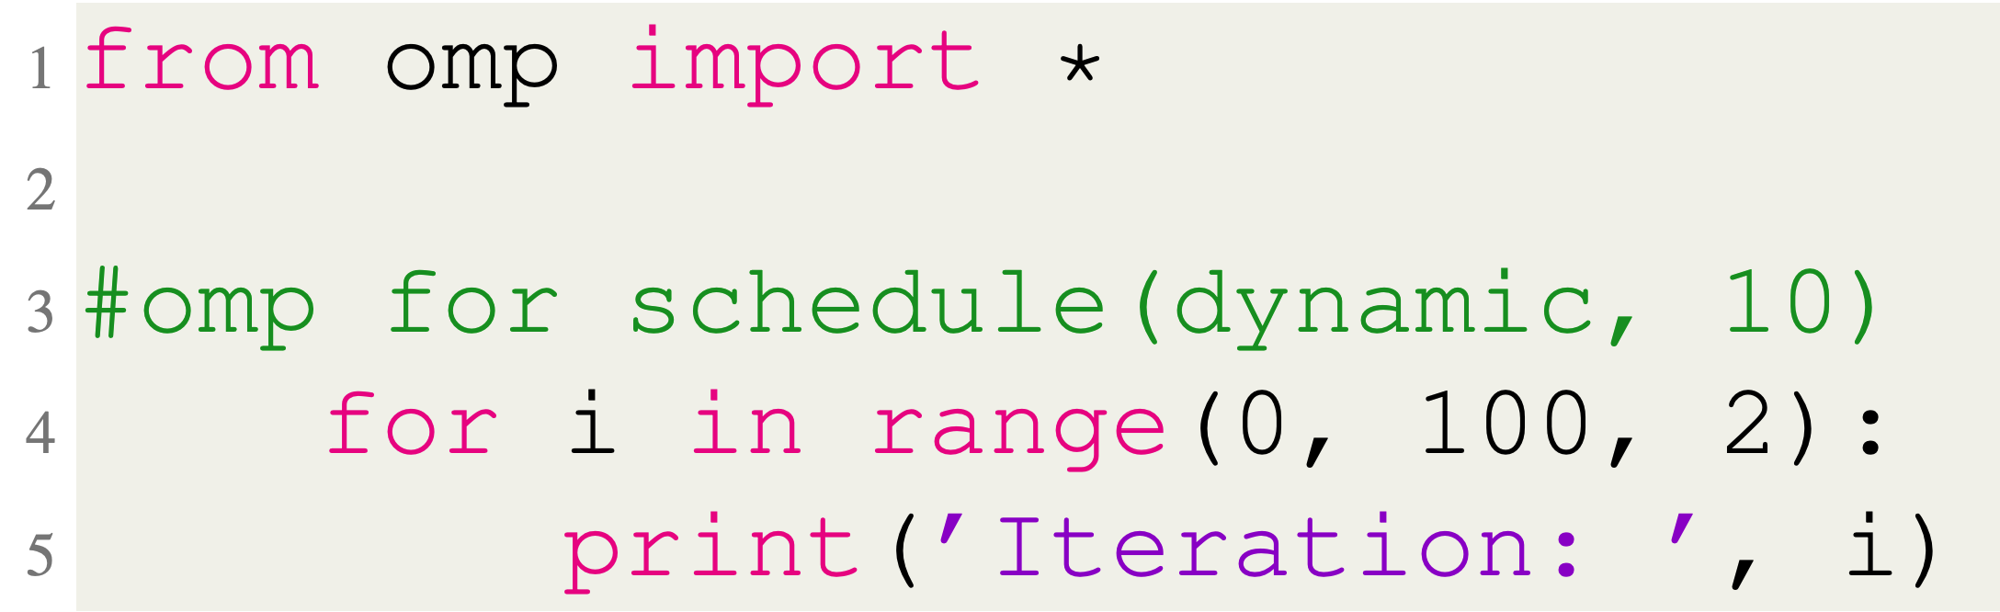
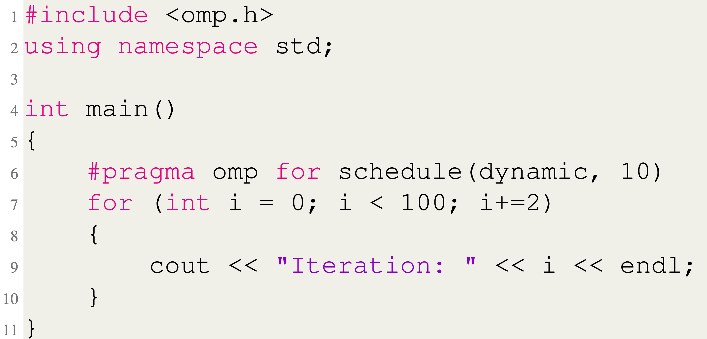
For Directive
Python
C++
Notes:
Implementing the for directive in python is a little less straightforward.
- Python doesn’t have the same for loop structure that C++ uses.
- Instead, python has for each loops.
- So, to make it work, we enforce restrictions on how the for loop following a for directive has to be structured.
- It has to look like this, for, and then a single variable.
- And then after the in, the next thing has to be the range function.
- And range can take 1, 2, or 3 parameters. If there are 3 given, the <NEXT> first is where the range will start, the <NEXT> second is the value to count up to, and the <NEXT> third is the step, so that’s the value that we increment by going through the range.
- You can see that functionally these values correspond to the three parts of a C++ for declaration.
- So again, <NEXT> we start at zero, <NEXT> we go as long as i is less than 100, and each iteration, <NEXT> we increment i by two.
- So, this may be a little weird at first if you don’t have experience with python, but in general, this is how you replicate the behavior of a for loop in python

Slide 20
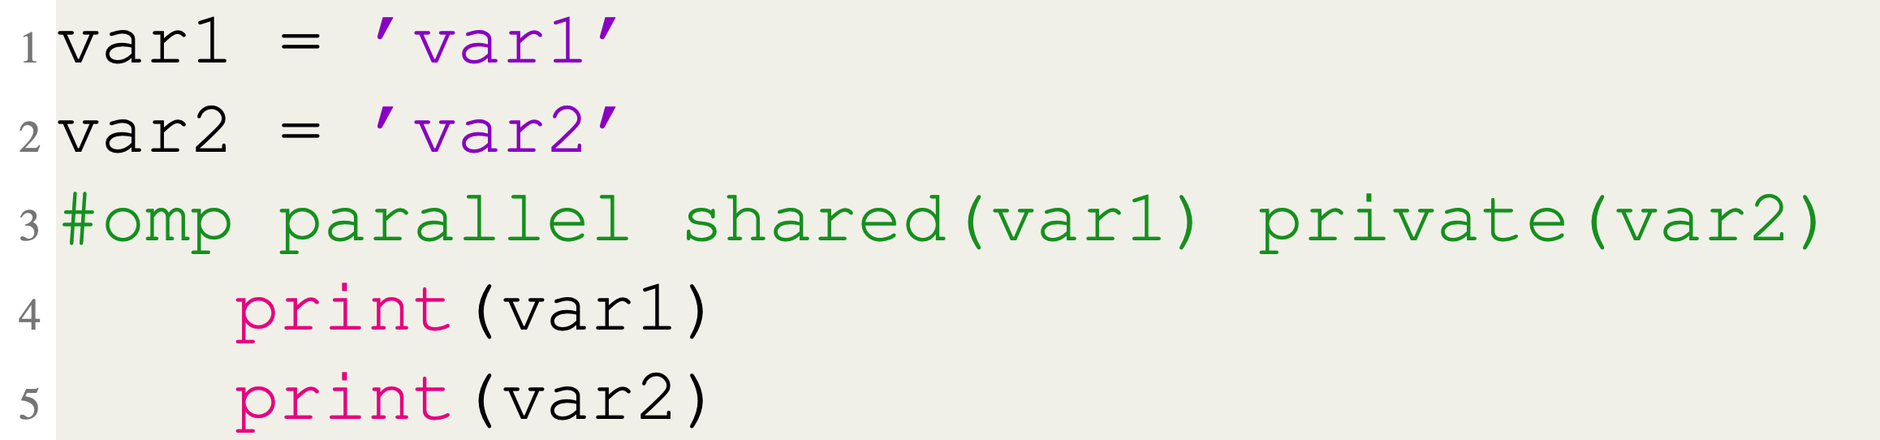
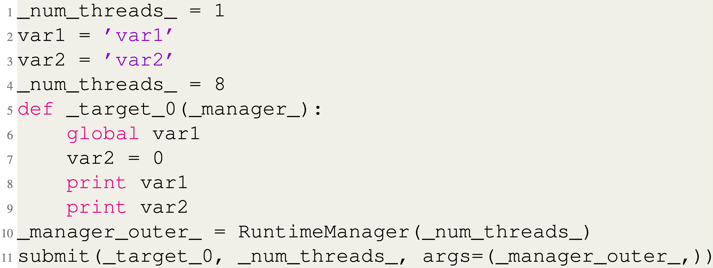
Source-to-source Translation
OpenMP Input Code
Preprocessor Output Code
Notes:
Here is an example of how an OpenMP parallel directive is translated by the preprocessor.
- The purpose of the parallel directive is to spawn new threads and execute the following block in parallel.
- <NEXT> First, if the num_threads clause is not present, then the number of threads that get spawned will default to the output of os.cpucount(), which is just a python standard library call.
- In this case it was 8 because my laptop has 8 virtual cores.
- Also, the reason that the variable starts and ends with an underscore is because it was created by the preprocessor.
- This is to prevent collisions with user variable names. So, we make it a requirement that user variables can’t start and end with an underscore.
- <NEXT> This is the target function declaration that gets passed to the threads to execute.
- <NEXT> This line shows how the shared clause works.
- The global keyword binds the var1 from the outer scope to the inside scope, making a shared variable.
- <NEXT> This line is the private clause. Python has what is called the copy-on-write rule.
- The way it works is that any variable from the outer scope is available in the inner scope as long as you only read from it.
- As soon as you write to the variable, a local version is created, and you are no longer referring the variable from the outer scope.
- So as soon as var2 is set to 0, it becomes a local, or private variable.
- <NEXT> After the function declaration, a RuntimeManager object is created.
- Every parallel target gets passed this object even if it doesn’t get used, like in this example.
- But the RuntimeManager is used for anything that requires information from all the threads to be collected, like a reduction, or for all the threads to have access to the same object like locks.
- Finally, <NEXT> the submit function executes the target with the specified number of threads and then returns

Slide 21
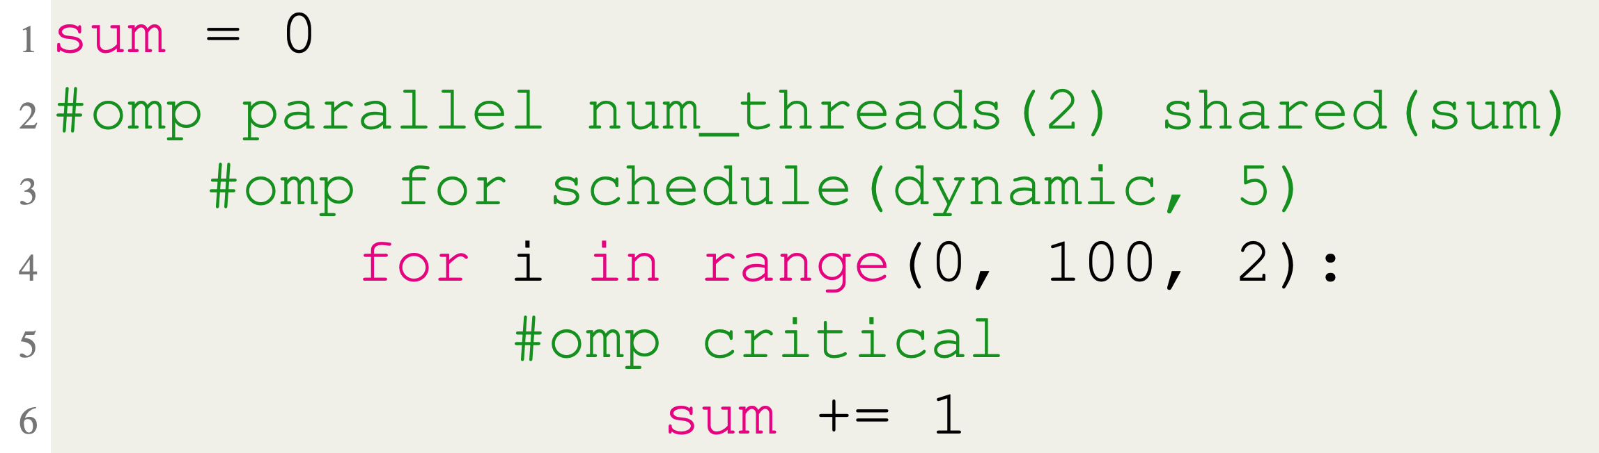
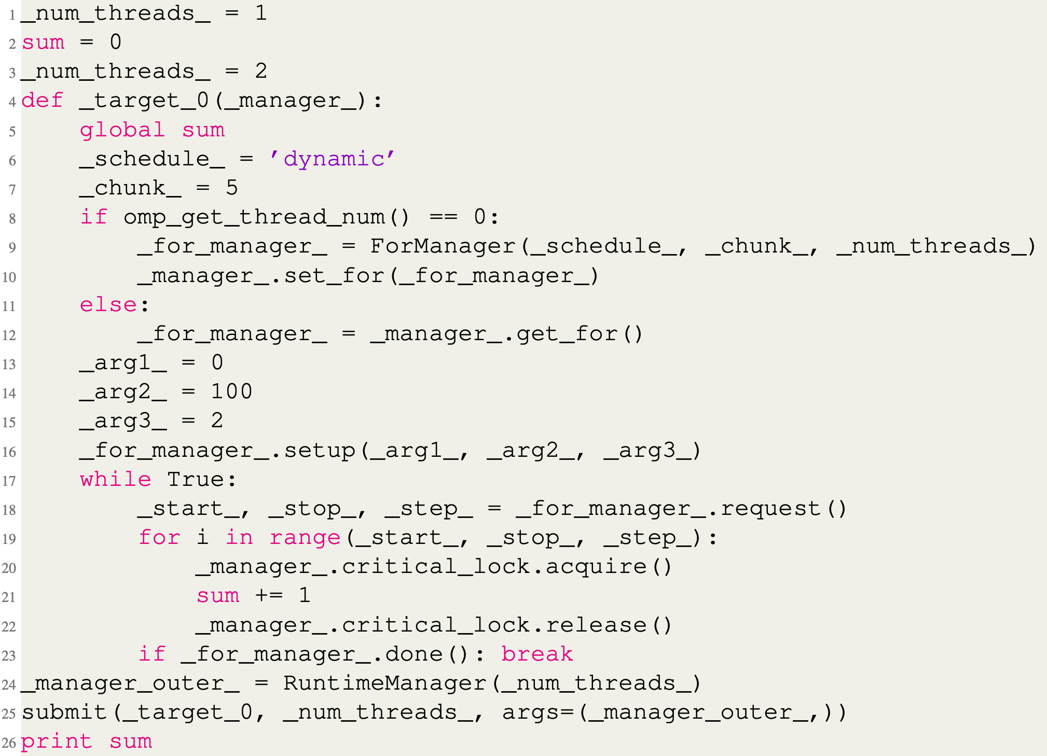
Source-to-source Translation
OpenMP Input Code
Preprocessor Output Code
Notes:
Here is another example.
- This time it’s a for directive inside of a parallel directive.
- <NEXT> At lines 6 and 7, the schedule and chunk variables are set to the values from the schedule clause.
- If the schedule clause isn’t included, then it will default to a static schedule with a chunk size of approximately the number of iterations divided by the number of threads.
- <NEXT> In this if block, the main thread creates a manager object to feed the chunks to the threads according to the schedule.
- <NEXT> These three variables correspond to the three parameters given to the range function.
- If only 1 or 2 parameters are given, then the others are set to None, which is like null in C++, and the manager will figure out what the range should be.
- <NEXT> The setup function just initializes the manager with the range parameters.
- <NEXT> And then we get to the actual structure of the OpenMP for construct, which is an infinite loop, where each thread <NEXT> requests the next block of iterations to execute, and this continues until the <NEXT> done method of the manager returns true and the threads break out.
- Lastly, <NEXT> this line shows where the critical section starts by acquiring a lock
- A critical section is any code that needs to serialized to get correct results, like updating a shared variable, in this case.
- And then it ends <NEXT> here by releasing the lock

Slide 22
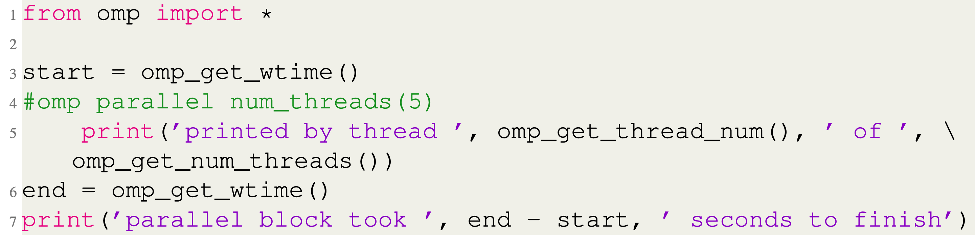
Runtime API
Notes:
Since there are only three functions in our runtime API, I put them all into one example.
- <NEXT> The omp_get_wtime() function is a wrapper around the Python time.time() function from the standard library.
- It returns the number of seconds from some arbitrary time in the past which is guaranteed not to change during the course of the program.
- So, the time we get back is always relative to the same time in the past which is important.
- <NEXT> Here, each thread prints which thread it is, which is its id, and out of how many total threads that are executing the parallel region using the omp_get_thread_num() and omp_get_num_threads() functions.
- <NEXT> Here we get the time again, and then the last statement <NEXT> prints the time it took the code to execute by subtracting the start time from the end time

Slide 23
Demo

Slide 24
Performance
Microbenchmarks
Windows 10 machine
6 cores/12 hardware threads
Average of 20 runs
* Results obtained using same OpenMP block for all runs, including 1 thread
Notes:
Now let’s talk about performance.
- We tested the performance using two microbenchmarks based on simple parallel algorithms.
- All tests were run on a windows 10 machine with 6 cores and 12 threads.
- And each data point is the average of 20 runs.
- Also, all of the results were obtained using an OpenMP block even for the serial runs.
- The reason for this is that I ran the tests the first time with a separate serial code block, and the results didn't make sense.
- We were often getting superlinear speedup
- We suspect that this was because the main thread is doing some extra garbage collection or something like that and making the serial version look slower than it should be.
- So, running the tests through an OpenMP block makes sure they all get a new thread

Slide 25
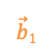
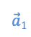
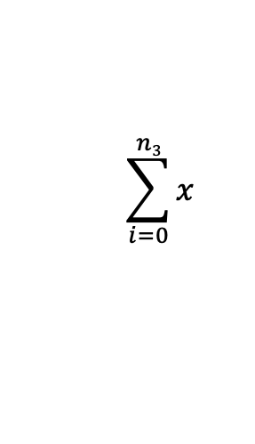
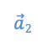
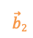
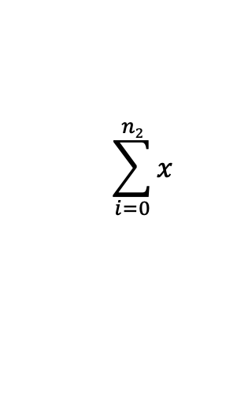
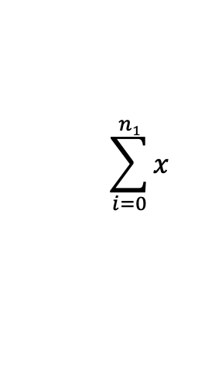
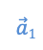
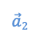
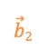

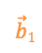
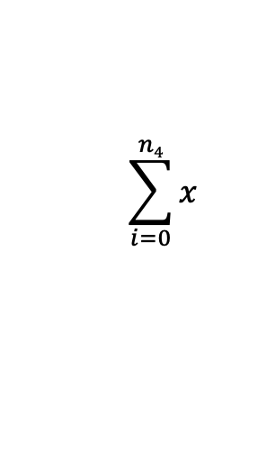
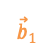
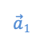
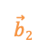
Performance
Microbenchmarks
N x N Matrix Multiplication
Matrices stored in jarray
Random Integers
Row wise partitioning
1, 2, 4, 8, and 12 threads
Parallel Sum
Integers stored in jarray
Divided evenly among threads
1, 2, 4, 8, and 12 threads
$$\vec{b}1$$
$$\vec{b}2$$
$$\sum_{i=0}^{n1}{x}$$
$$\sum_{i=0}^{n2}{x}$$
$$\sum_{i=0}^{n3}{x}$$
$$\sum_{i=0}^{n4}{x}$$
↙
↙
.
.
$$\vec{a}1$$
↙
1
7
.
1
7
=
$$\vec{a}1$$
$$\vec{b}1$$
$$\vec{a}1$$
$$\vec{b}2$$
$$\vec{a}2$$
.
.
↙
2
4
2
4
$$\vec{a}2$$
$$\vec{b}1$$
$$\vec{a}2$$
$$\vec{b}2$$
A
B
C
Notes:
The first microbenchmark we used was n by n matrix multiplication with row-wise partitioning.
- And the second was parallel sum.
- Both used a single jarray object to store the data, which was random integers in both cases.
- And both tests ran with 1, 2, 4, 8, and 12 threads

Slide 26
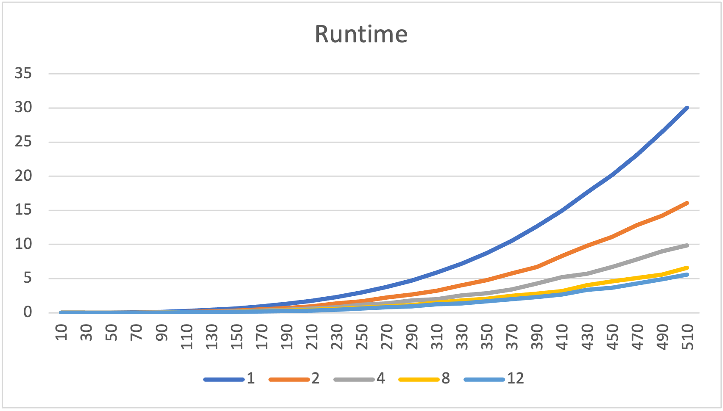
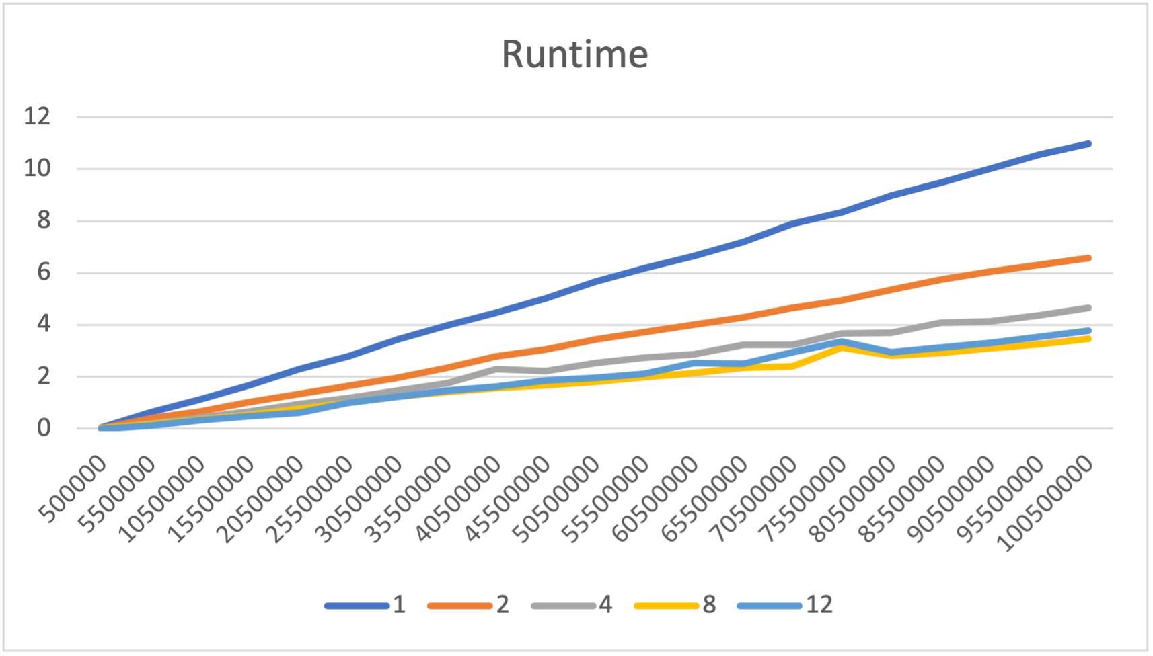
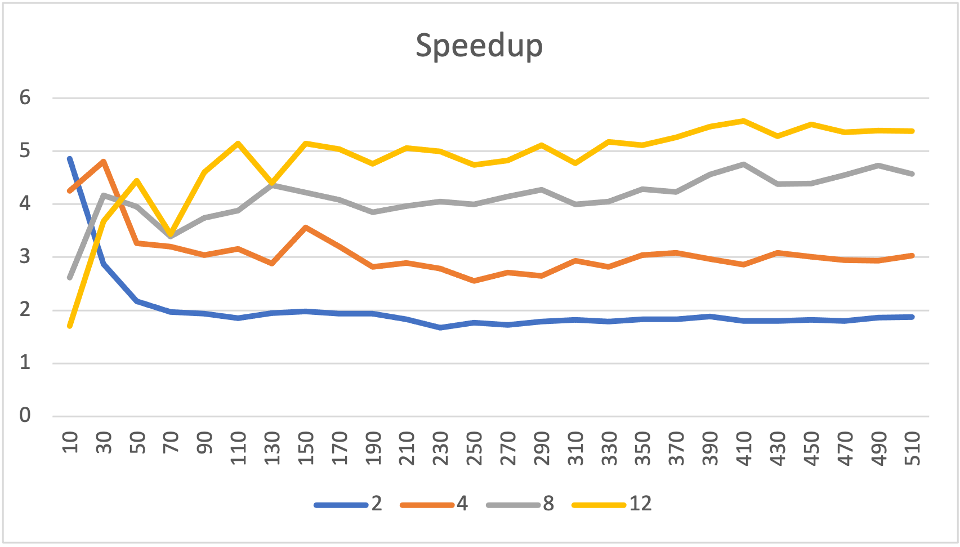
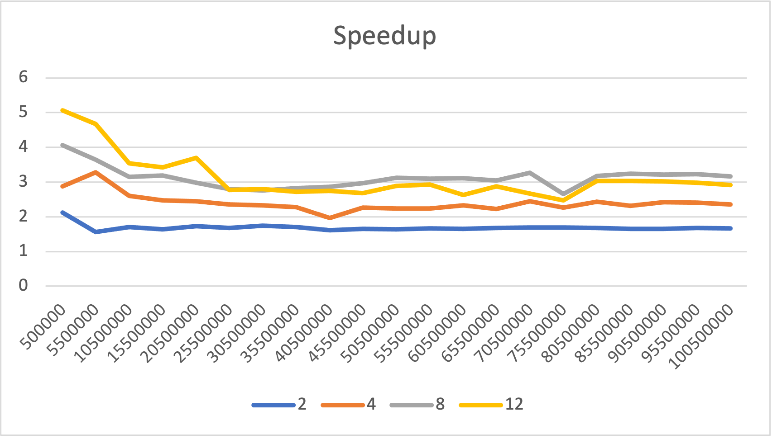
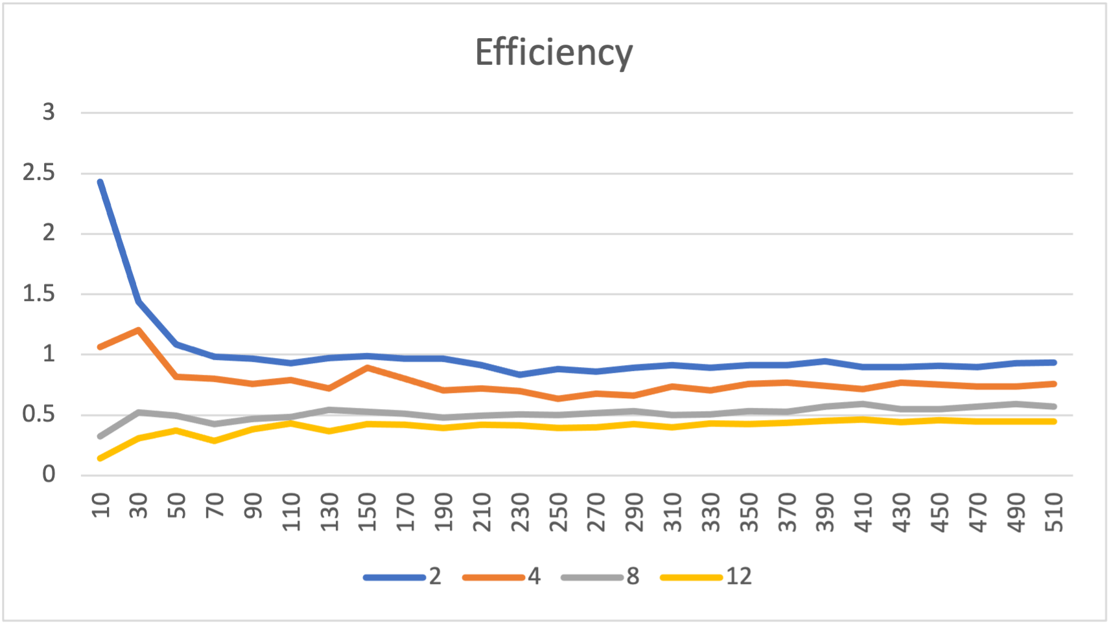
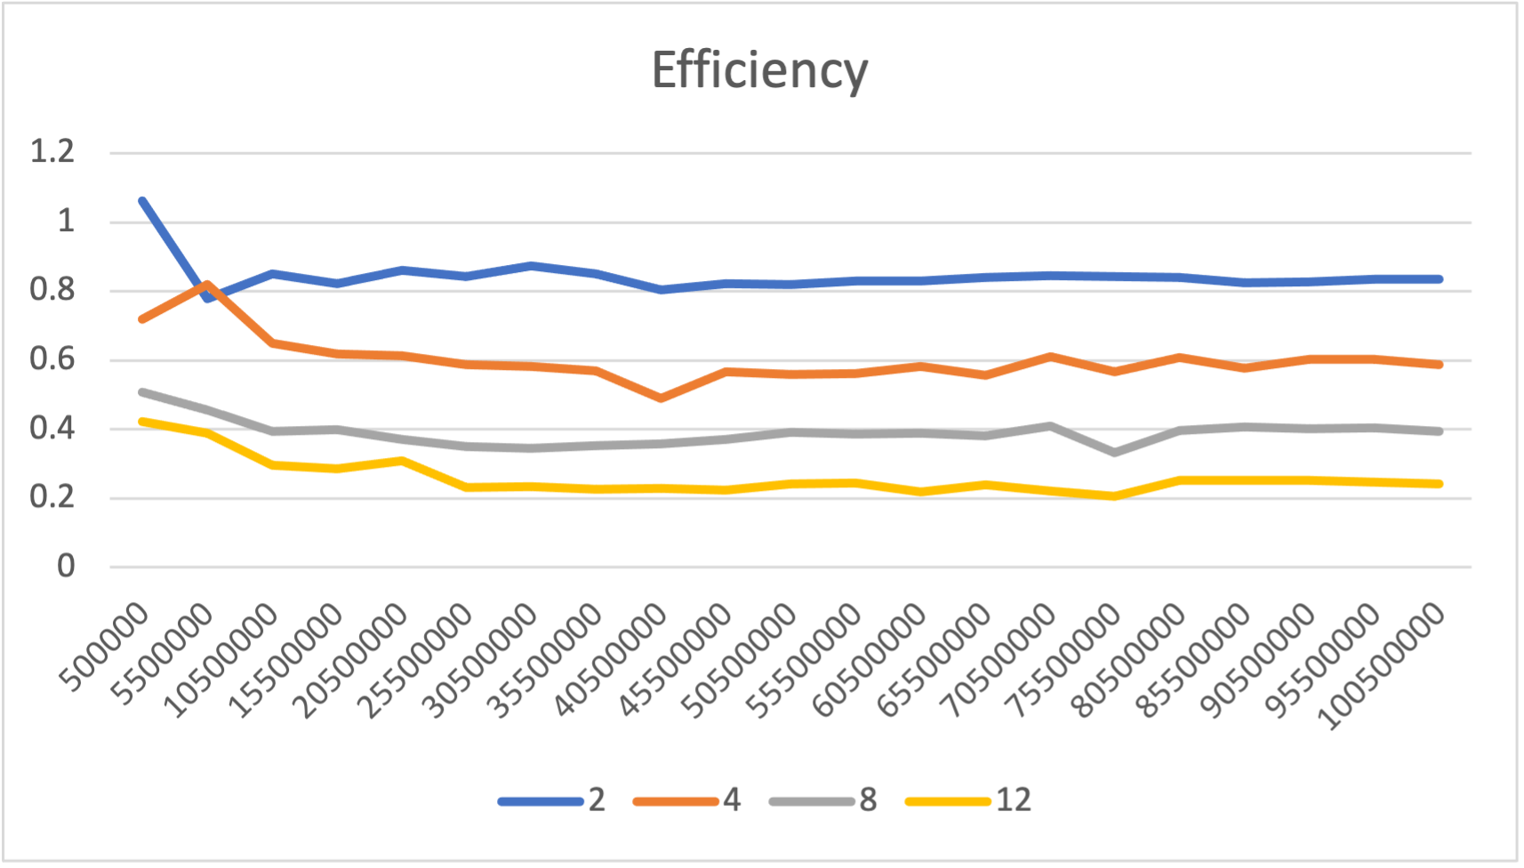
Parallel Matrix Multiplication
Parallel Sum
Notes:
Here are the results.
- The numbers on the x axis are the problem size, so that’s 1 dimension of a matrix for matrix multiplication and then the number of integers that were added up for parallel sum.
- In terms of runtime, you can see that it takes less time to finish the more threads we use except for 8 and 12 threads on parallel sum, they kind of went back and forth.
- For the speedup, the pattern is interesting.
- Some of them started off high and then declined some and leveled off. And on the efficiency, we actually got higher than 1 for 2 and 4 threads on matrix multiplication and 2 threads on parallel sum at the beginning.
- We suspect the reason for this has to do with the just in time compilation of jython.
- So, on the first run, it has to convert the target function to java bytecode before it can be run and then all the runs from then on don’t have to do that, so it makes all the parallel runs look faster in relation to that first run because they don't have that extra overhead.
- But aside from that, these results are good enough to demonstrate parallelism, which is our goal, not to have amazing performance

Slide 27
Conclusions & Future Work
Core directives, clauses, functions implemented
Fit OpenMP style/syntax to Python conventions
Tested performance with two microbenchmarks
Results adequate for teaching parallel concepts
Extensive user testing
Test with IDEs
Investigate performance, more benchmarks
Add more functionality
Iterative improvement
Notes:
In conclusion, we have implemented core OpenMP directives, clauses, and a runtime library in Python.
- We’ve made significant progress towards our design goals of having a usable, robust tool for teaching parallel concepts even if we're not there just yet.
- We have tested the performance with two microbenchmarks and the results so far are adequate for our purposes.
- In the future, we plan to do extensive user testing to find any bugs and get user feedback on the usability.
- We also want to work with IDEs and see how the usability is and what improvements we can make there.
- We will further investigate our performance results and run more benchmarks.
- And we will add more functionality, like task parallelism, and hopefully bring more people on to the project to continue improving it over time

Slide 28
Thank you!

Slide 29
References
[1] D. J. Ernst and D. E. Stevenson, “Concurrent cs: preparing students for a multicore world,” in Proceedings of the 13th annual conference on Innovation and technology in computer science education, pp. 230–234, 2008.
[2] Y. Ko, B. Burgstaller, and B. Scholz, “Parallel from the beginning: The case for multicore programming in thecomputer science undergraduate curriculum,” in Proceeding of the 44th ACM technical symposium on Computer science education, pp. 415–420, 2013. [3] J. C. Adams, “Injecting parallel computing into cs2,” in Proceedings of the 45th ACM technical symposium on Computer science education, pp. 277–282, 2014.
[4] B. Neelima and J. Li, “Introducing high performance computing concepts into engineering undergraduate curriculum: a success story,” in Proceedings of the Workshop on Education for High-Performance Computing, pp. 1–8, 2015.
[5] J. R. Graham, “Integrating parallel programming techniques into traditional computer science curricula,” ACM SIGCSE Bulletin, vol. 39, no. 4, pp. 75–78, 2007.
[6] R. Brown and E. Shoop, “Csinparallel and synergy for rapid incremental addition of pdc into cs curricula,” in 2012 IEEE 26th International Parallel and Distributed Processing Symposium Workshops & PhD Forum, pp. 1329–1334, IEEE, 2012.
[7] R. Brown and E. Shoop, “Modules in community: injecting more parallelism into computer science curricula,” in Proceedings of the 42nd ACM technical symposium on Computer science education, pp. 447–452, 2011.
[8] J. Adams, R. Brown, and E. Shoop, “Patterns and exemplars: Compelling strategies for teaching parallel and distributed computing to cs undergraduates,” in 2013 IEEE International Symposium on Parallel & Distributed Processing, Workshops and Phd Forum, pp. 1244– 1251, IEEE, 2013.
[9] W. Ahmed, M. M. Muthaher, and J. M. Basheer, “Introducing high performance computing (hpc) concepts in institutions with an absence of hpc culture,” in 2013 Sixth International Conference on Contemporary Computing (IC3), pp. 274–277, IEEE, 2013.

Slide 30
References
[10] S. A. Bogaerts, “Limited time and experience: Parallelism in cs1,” in 2014 IEEE International Parallel & Distributed Processing Symposium Workshops, pp. 1071–1078, IEEE, 2014.
[11] B. L. Kurtz, C. Kim, and J. Alsabbagh, “Parallel computing in the undergraduate curriculum,” in Proceedings of the twenty-ninth SIGCSE technical symposium on Computer science education, pp. 212–216, 1998.
[12] G. Lu, J. Xu, J. Liu, B. Dai, S. Gui, and S. Zhan, “Integrating parallel and distributed computing topics into an undergraduate cs curriculum at uestc,” in 2015 IEEE International Parallel and Distributed Processing Symposium Workshop (IPDPSW), (Los Alamitos, CA, USA), pp. 782–787, IEEE Computer Society, may 2015. 13
[13] S. Ghafoor and M. Rogers, “ipdc workshop.” https://www.csc.tntech.edu/ pdcincs/.
[14] J. M. Bull and M. E. Kambites, “Jomp—an openmp-like interface for java,” in Proceedings of the ACM 2000 conference on Java Grande, pp. 44–53, 2000.
[15] N. Giacaman and O. Sinnen, “Pyjama: Openmp-like implementation for java, with gui extensions,” in Proceedings of the 2013 International Workshop on Programming Models and Applications for Multicores and Manycores, pp. 43–52, 2013.
[16] P. Belohl ˇ avek, “Openmp for java,” 2015.

Slide 31
Image References
[f.1] https://www.vecteezy.com/free-vector/laptop
[f.2] https://www.olcf.ornl.gov/summit/
[f.3] https://www.vecteezy.com/free-vector/university
[f.4] https://www.vecteezy.com/free-vector/school
[f.5] https://www.vecteezy.com/free-vector/programmer
[f.6] https://www.tntech.edu/ocm/marketingtoolkit/assets.php
[f.7] https://bholley.net/blog/2015/must-be-this-tall-to-write-multi-threaded-code.html
[f.8] https://www.geeksforgeeks.org/multithreading-python-set-1/
[f.9] https://www.vecteezy.com/free-vector/barrier
[f.10] https://www.pngitem.com/
[f.11] https://www.pngitem.com/

Slide 32
Questions?

